Slide 1
PROJECT TITLE
CAPSTONE PROJECT
Presented By: Edunet Foundation
Student Name : Jadhav Shital Arjun
College Name & Department : Government College Of Engineering And Researh Avasari Khurd Pune

Slide 2
OUTLINE
Problem Statement
Technology used
Wow factor
End users
Result
Conclusion
Git-hub Link
Future scope

Slide 3
Problem Statement
Secure Data Hiding In Images Using Steganography

Slide 4
Technology used
Platform : VS code
Libraries : Pillow (PIL):
A more user-friendly image processing library that is used for basic image operations like opening, editing, and saving images.
Stegano:
A Python library specifically designed for steganography tasks. It includes simple implementations of popular steganography algorithms like LSB.

Slide 5
Wow factors
1. Advanced Encryption and Compression Integration:
2. Secure Data Transmission and Storage
3. Hybrid Steganography Techniques:
4. Robustness Against Image Manipulation:
5. Stego-image Quality Preservation:
6. Multi-layered Data Hiding:
7. Real-time Hiding and Extraction:

Slide 6
End users
Individuals (Personal Use)
Businesses and Corporations
Government Agencies
Academics and Researchers
Cybersecurity Professionals
Cloud and Data Storage Providers
Media and Entertainment Industry
Cryptographers and Security Enthusiasts
Educational Institutions

Slide 7
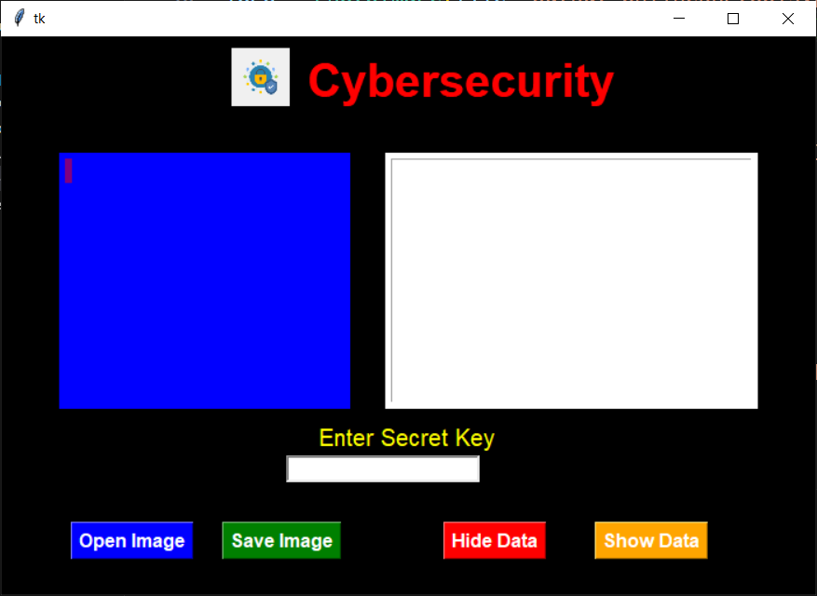
Results

Slide 8
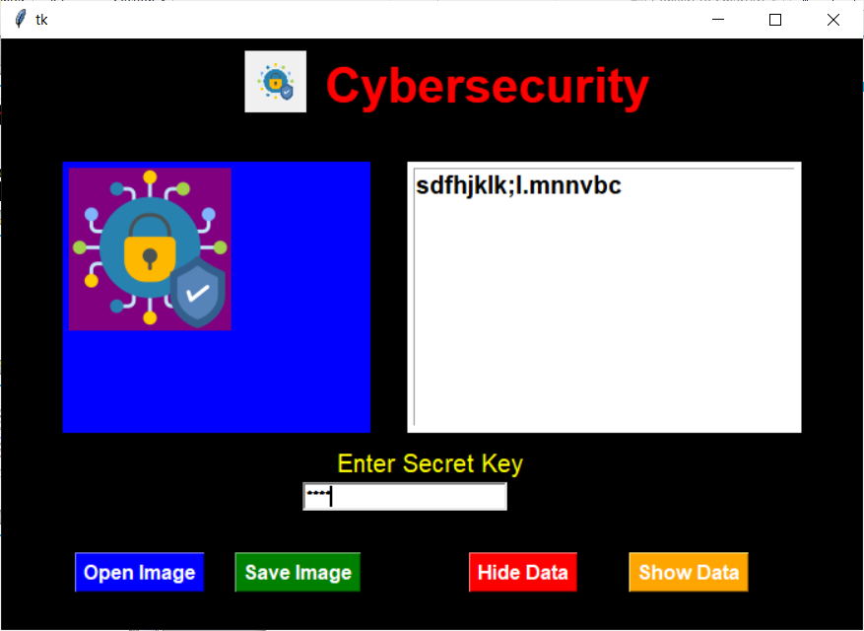

Slide 9
Conclusion
This project successfully addresses the problem of secure data transmission by employing steganography in combination with encryption and compression techniques to hide data within images in a way that is both invisible and secure. The system ensures that sensitive information is protected from unauthorized access and detection while maintaining the integrity and visual quality of the image.
The ability to securely store and transmit data without detection has wide-ranging applications, from personal privacy to corporate security, and it contributes to the ongoing advancement in data protection technologies. By offering a solution that balances security, efficiency, and usability, this project provides a meaningful tool for anyone needing a discreet and secure way to transmit or store sensitive information in the digital world.
This project lays a strong foundation for future research and development in the field of secure digital communication, offering the potential for integration into larger systems for data privacy, cybersecurity, and digital forensics.

Slide 10
GitHub Link
Githhub :https://github.com/shital1-23/Cybersecurity.git

Slide 11
THANK YOU

